Slide 1
Macroeconomic Insights Affecting Your Business Decisions
Presentation for Diversified Insurance Services
February 20, 2013
Merton D. Finkler, Ph.D
John R. Kimberly Distinguished Professor in the American Economic System

Slide 2
Agenda – The Economy
The Macroeconomy
  Patterns and trends
  Key indicators to watch
  Guidance
Health Care Markets
  Patterns and trends
  Health care reform – the role of exchanges
  Guidance

Slide 3
Agenda- Business Decision Making
Criteria to be used
  Return
  Risk
  Stability
Risk identification – what could jeopardize existing business models
Tradeoffs

Slide 4
Macroeconomic Trends - I
The NBER reviews 4 indicators to determine recession and recovery periods
  Industrial Production
  Real Income
  Employment
  Real Retail Sales

Slide 5
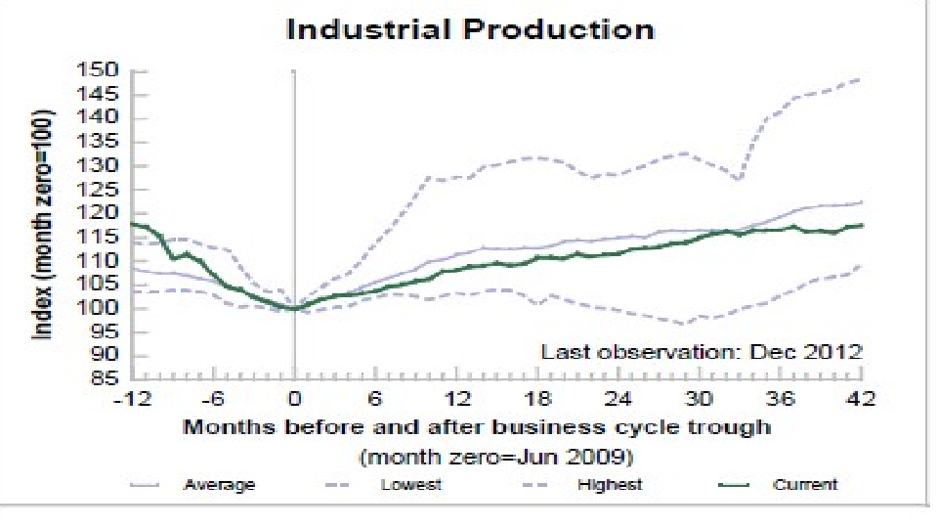
Post WWII Industrial Production
Business Cycles

Slide 6
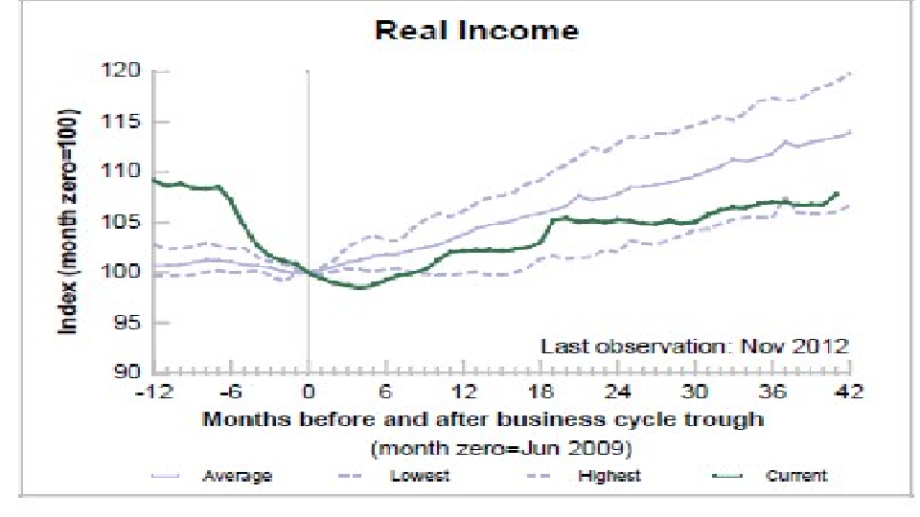
Post WWII -Real Income
Business Cycles

Slide 7
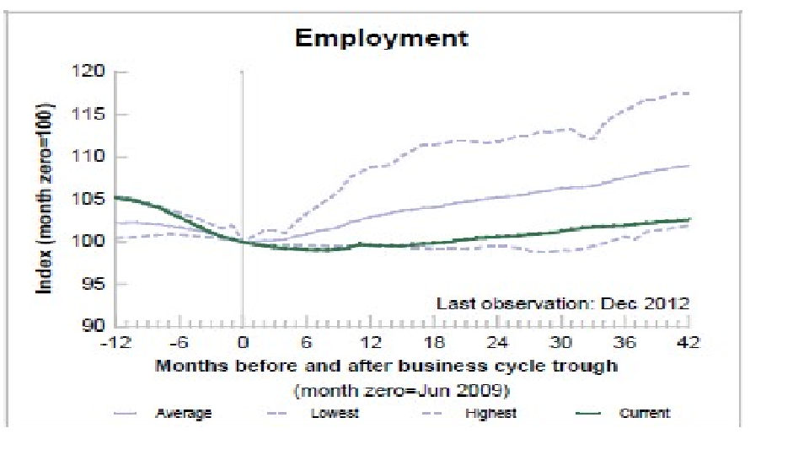
Post WWII Employment
Business Cycles

Slide 8
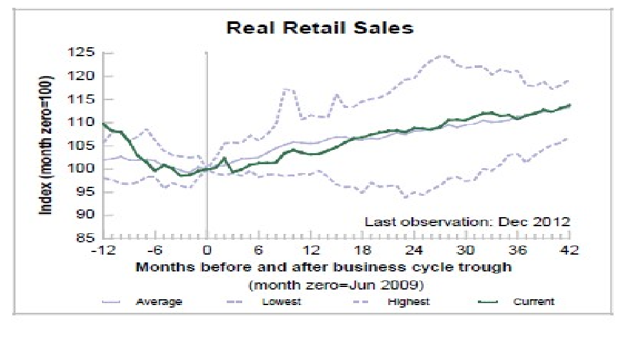
Post WWII Real Retail Sales Business Cycles

Slide 9
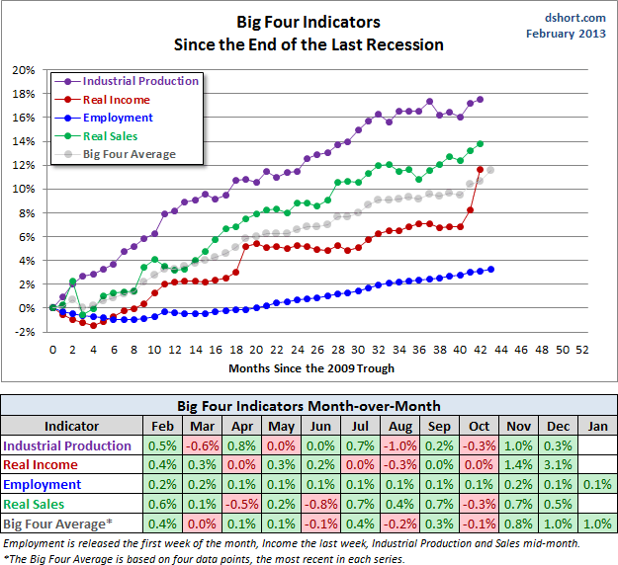
Big 4 Indicators Since Trough

Slide 10
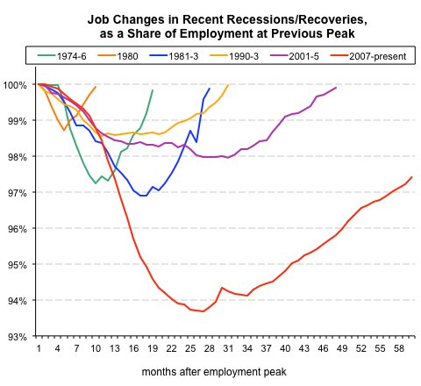
Employment Downturn

Slide 11
Interpretation
Industrial Production and Real Retail Sales have responded to policy stimuli as in the past
Real Income has responded more weakly than in the past but has started to grow a bit more rapidly
Employment response has been much slower than in the past and much less responsive to monetary and fiscal stimuli – jobless recovery
Even in GDP terms, the economy remain 5-6% below its potential based on pre-2007 growth

Slide 12
Unsustainable Trends
Total Debt to GDP – Large industrialized economies
Negative Real Yields on Treasuries
Household Debt to GDP levels
Federal Debt to GDP levels
Bank Excess Reserves

Slide 13
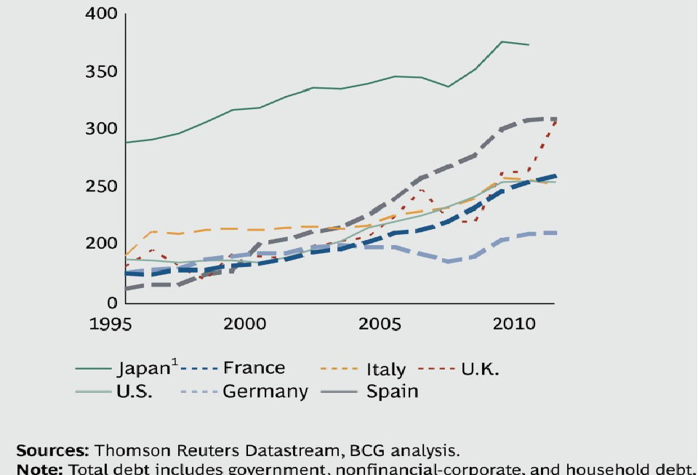
Total Debt to GDP – 1995 - 2011

Slide 14
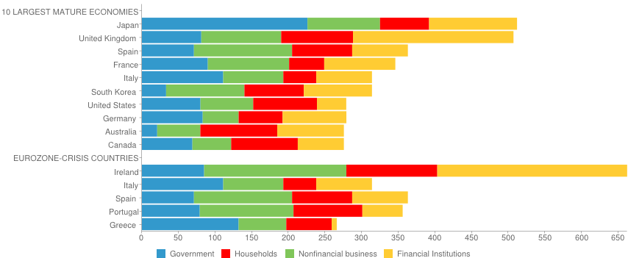
Debt Composition as % of GDP
Notes:
We can’t just look at government debt. Key source varies across countries and across time.

Slide 15
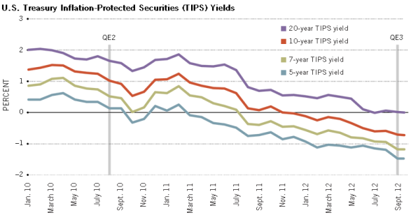
Negative Real Yields

Slide 16
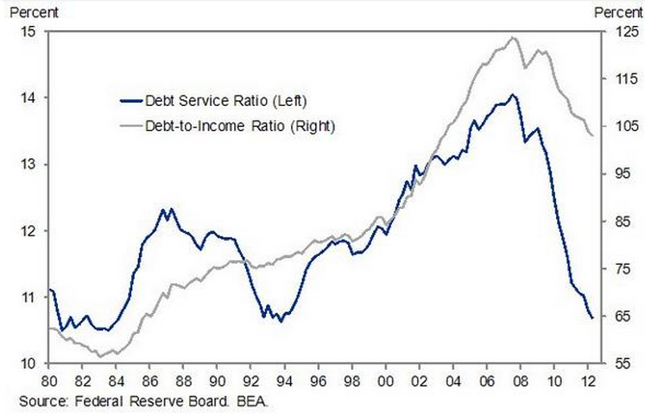
Household Debt and Debt Service
Relative to HH Income
Notes:
Debt service includes mortgage and consumer debt; There also exists financial obligations ratio which includes auto leases, rental payments on tenant occupied property, homeowners insurance, and property taxes.

Slide 17
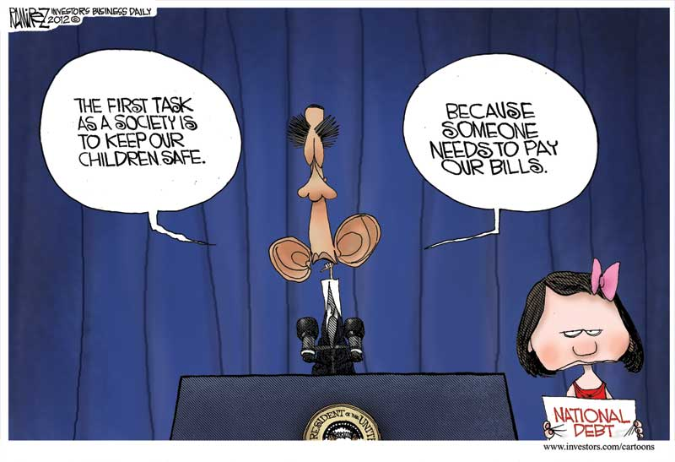
The Burden of the National Debt

Slide 18
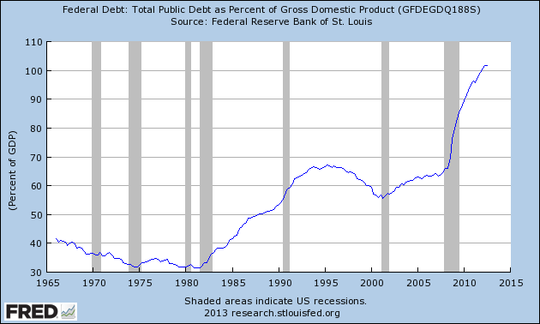
Total Public Debt to GDP
Notes:
About a third of which is held by government agencies, not including the FED.

Slide 19
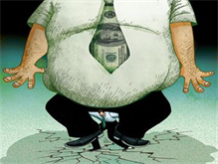
The Unstarvable Beast

Slide 20
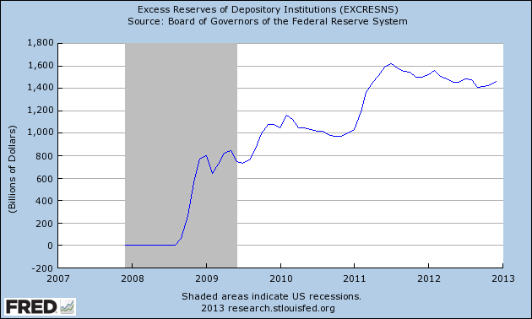
Excess Reserves

Slide 21
Dual Mandate for the Federal Reserve
"The Board of Governors of the Federal Reserve System and the Federal Open Market Committee shall maintain long run growth of the monetary and credit aggregates commensurate with the economy's long run potential to increase production, so as to promote effectively the goals of maximum employment, stable prices and moderate long-term interest rates.“ Congress, 1977 Act

Slide 22
Macroeconomic Stabilization Policy
Aggressive Monetary Policy
  QE I,II, and III – Balance sheet increases w/ ZIRP
  Explicit Policy Goals: Inflation <= 2.5%, U< 6.5%
Activist Fiscal Policy
  Relationship to business cycle – GDP gap remains
  Fiscal cliff (avoided?), fiscal policy, and cliff dwelling
No Long Term Focus
  JOBS Act is an exception (passed April 2012)
  Immigration reform
  Entitlement reform

Slide 23
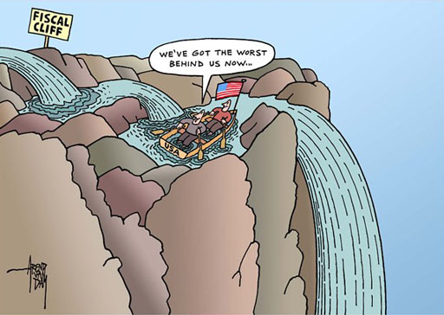

Slide 24
Monetary Policy “Outs” and “Ins”
Out
Inflation targeting
Fed manages short term Treasuries
One element of Macroeconomic Stabilization Policy
In
Explicit inclusion of UR and nominal GDP
Fed manages all Treasury maturities
Primary Macroeconomic Stabilization Policy
Notes:
Monetary independence may have gone out the door.

Slide 25
Macroeconomic Risks
Inflation – not on the horizon (observed and expected both matter)
Fed Policy – when will Fed ease up on the accelerator?
Federal Budget Deficit –short term impact on Aggregate Demand (e.g., ↑payroll tax, ↓Fed spending)
The Burden of Long Term US Debt – steady 70-80% of GDP for marketed portion
All countries want to ↑exports → currency wars?
Notes:
Financial Repression is not a good long term strategy. Rogoff and Reinhart 90%

Slide 26
Guidance
Turning points in real interest rates – return to “moderate” long term real rates
Rapid decline in excess reserves or rise in bank and commercial loans
Marketed government debt to GDP levels - at what level will GDP growth↓? Lenders revolt?
Levels of economic policy uncertainty (www.policyuncertainty.com)

Slide 27
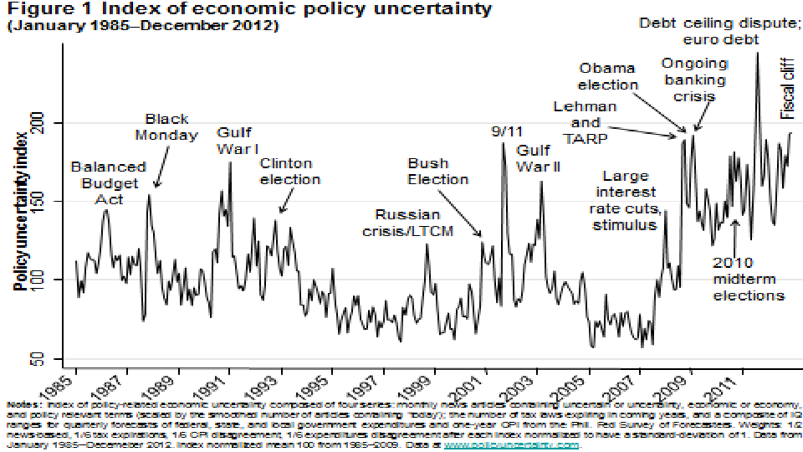
Index of Economic Policy Uncertainty

Slide 28
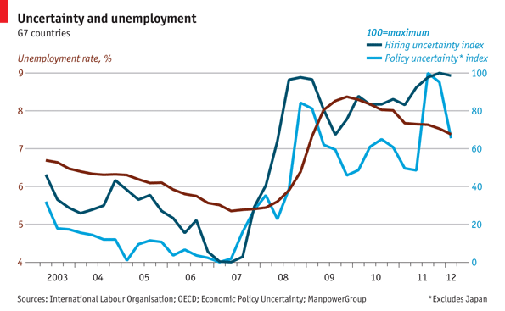
Economic Uncertainty Increases Unemployment

Slide 29
Part II - Health Expenditures and Macro Effects
The ↑“baby boomers” and limited Medicare reform from fee-for service model → Medicare share of GDP ↑ & ↑ contributor to deficit spending.
Serious reform of both the financing and the delivery of health care services is essential for sustainable budgets and economic growth.
Herbert Stein: “if something cannot go on forever, it will stop.”

Slide 30
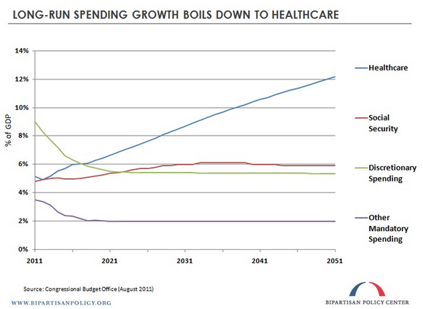

Slide 31
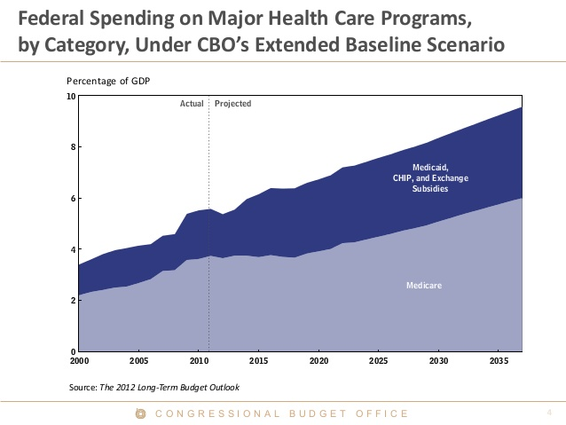
Federal Health Spending Projections
Notes:
There exists some evidence of a flattening of HC$ growth. Will it persist?

Slide 32
Health Expenditure Trends
Growth in per capita expenses over time
Growth in health expenditures as share of GDP over time
Cross – country comparison are complex
Key result: growth in health care expenditures per year has exceeded growth in US income by 2.5% on average over the past 50 years

Slide 33
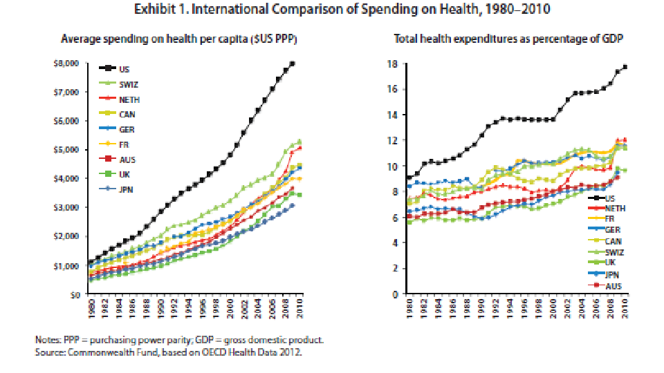
Global Health Expenditure Trends
Notes:
Left hand graph is misleading as PPP numbers tend to reduce European expenditure levels by 10 to 20 %.

Slide 34
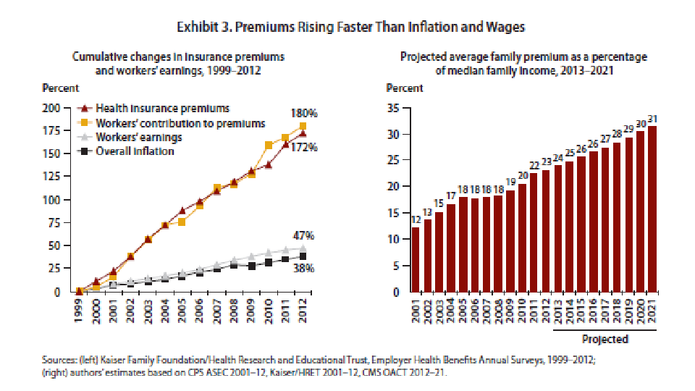
Increasing Burden of Health Insurance

Slide 35
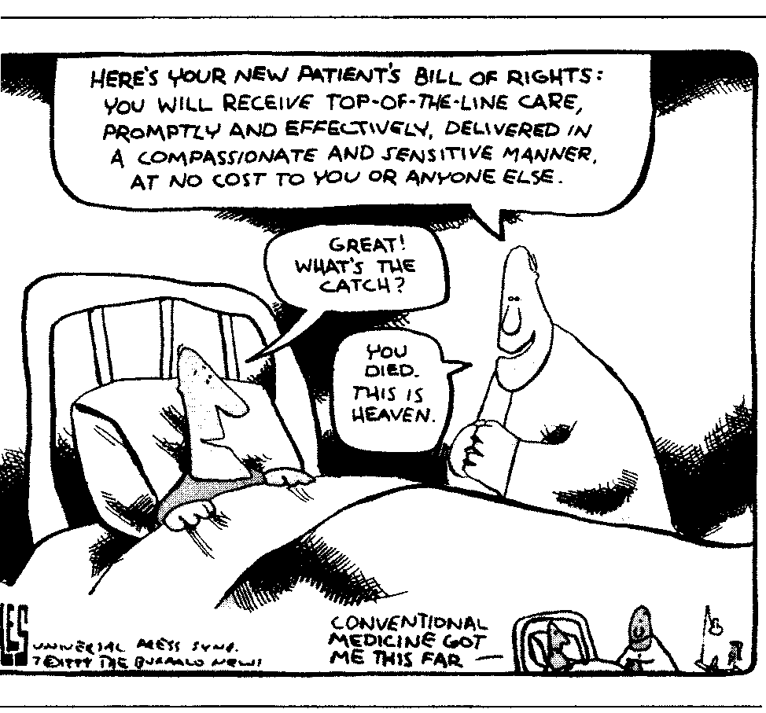
Health Care Nirvana

Slide 36
Is the Term “U.S. Health Care System” an Oxymoron? J. D. Kleinke (2001) thinks so.
“Health care in America combines the tortured, politicized complexity of the U.S. tax code with a cacophony of intractable political, cultural, and religious debates about personal rights and responsibilities.”
Central reality: “the primary producers and consumers of medical care are uniquely, stubbornly self-serving as they chew through vast sums of other people’s money.”
I call this the OPM (Other People’s Money) Principle.

Slide 37
Key Health Care Expenditure Drivers
An aging population
Increased chronic disease
Increased intensity of medical services and waste (i.e., services with costs >> benefits)
Market power (hospitals, specialists, insurers)

Slide 38
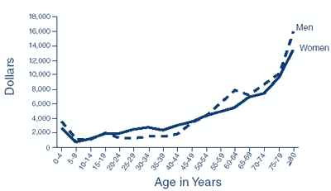
Demographics Complicate Choices
Those aged 45 – 64 spend roughly twice the
amount spent per person per year by those 18 - 44

Slide 39
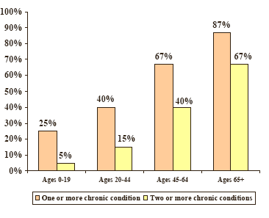
Chronic Disease Prevalence Rises More than Proportionately with Age
Medical Expenditures Panel Survey 2001

Slide 40
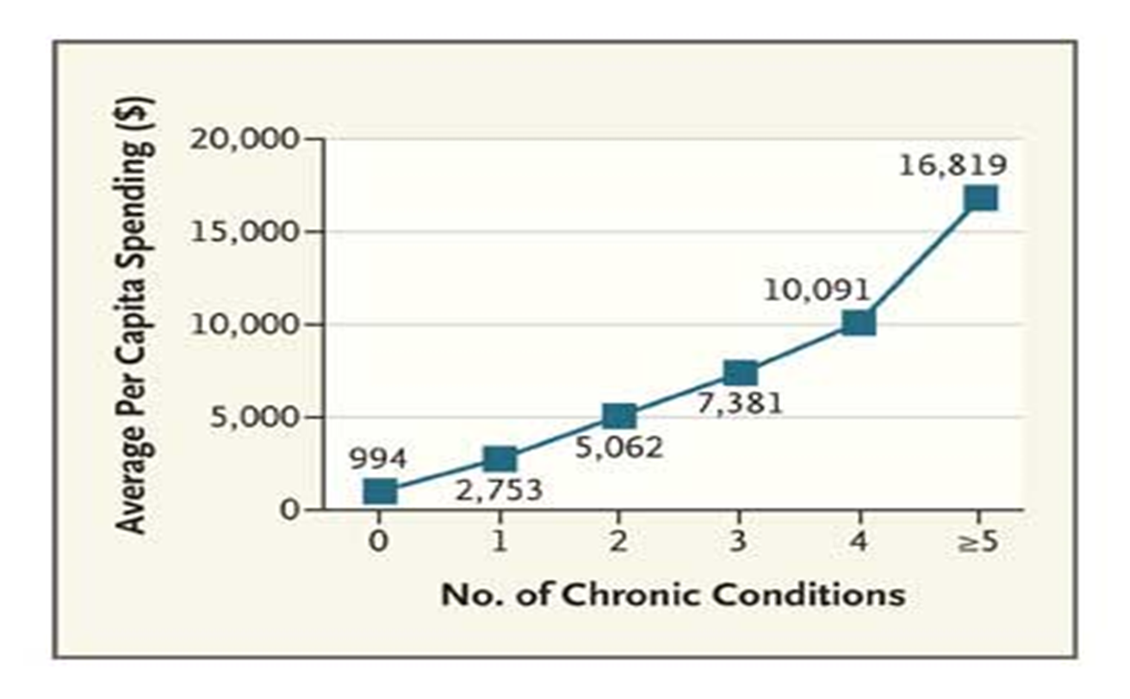
Chronic Conditions are Costly

Slide 41
The Impact of Chronic Disease

Slide 42
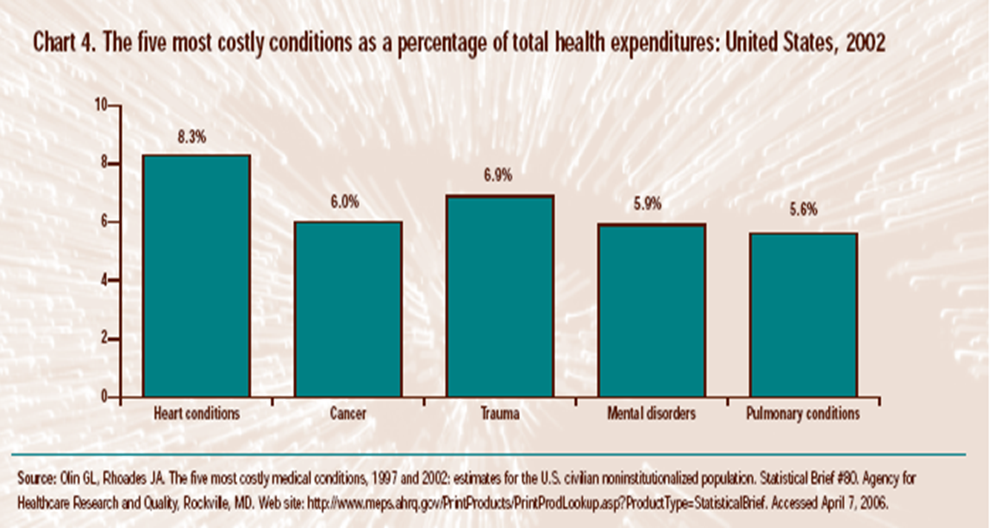
Most Costly Conditions

Slide 43
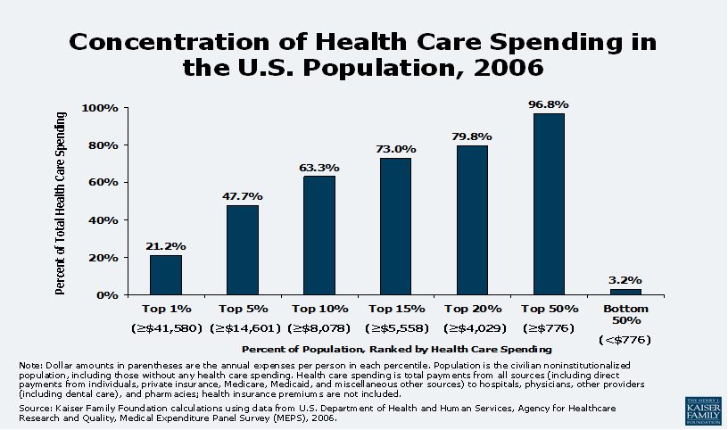
The 80–20 Rule Applies to Health Care

Slide 44
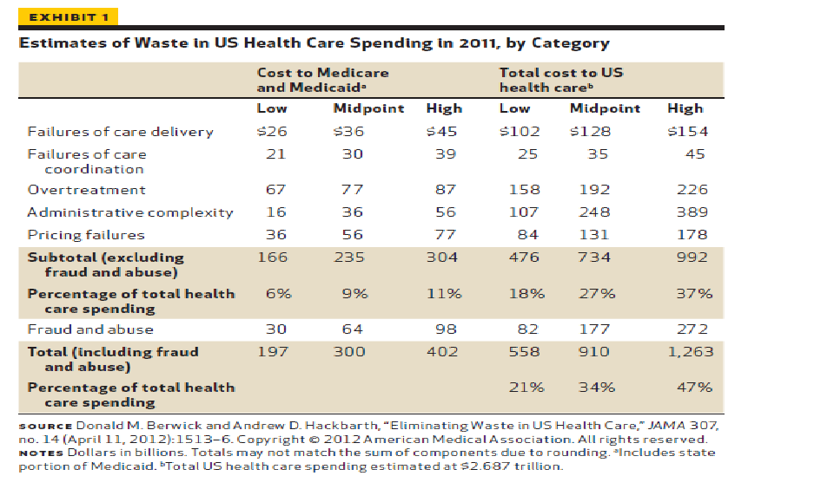
Wasteful Health Care Spending

Slide 45
The Three Primary Laws of Economics
The Law of Demand – all else equal, people buy less as the price rises
The Law of Supply – all else equal, providers supply more as the price rises
The Law of Competitive Markets- Under fairly strong assumptions, quantity supplied = quantity demanded at a Price = Long Run Marginal Cost
Competitive Markets are not common in health care

Slide 46
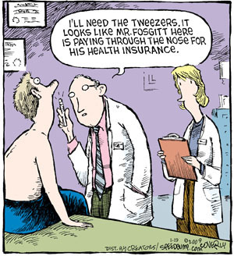
Pay Through the Nose!

Slide 47
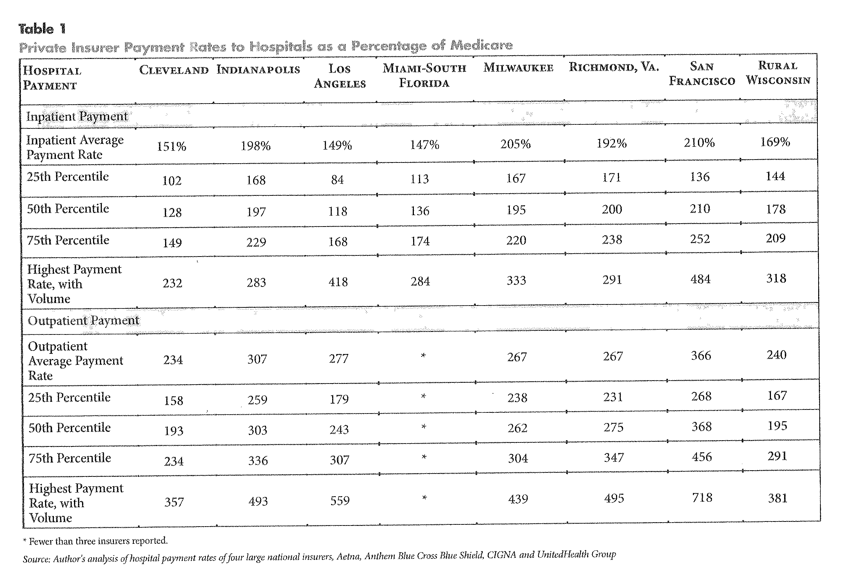
Milwaukee’s Hospital Prices are High

Slide 48
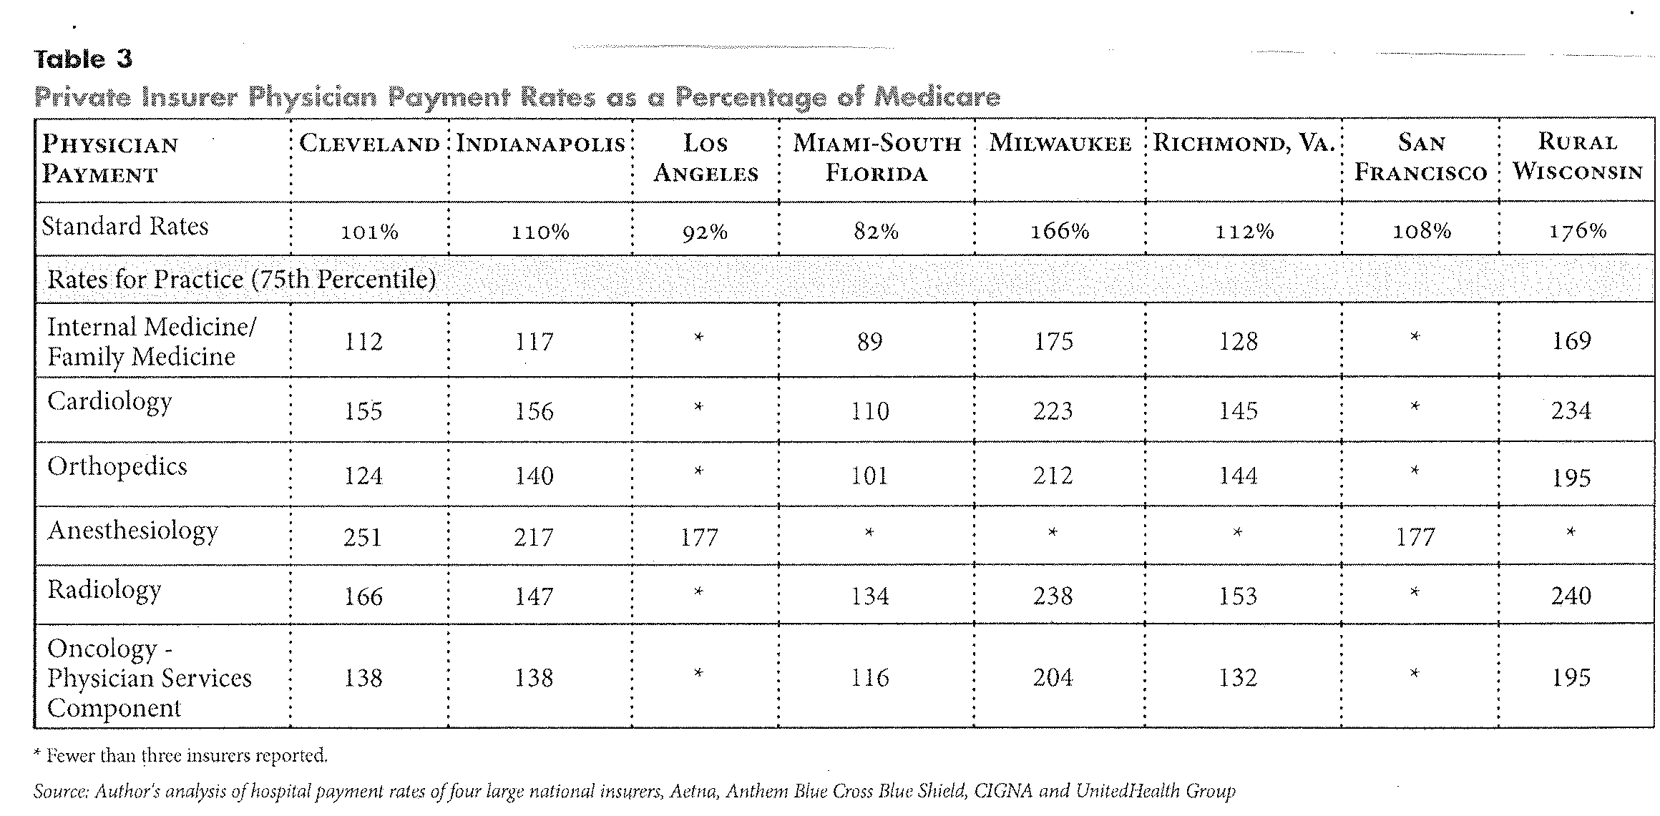
Milwaukee’s Physician Prices are High

Slide 49
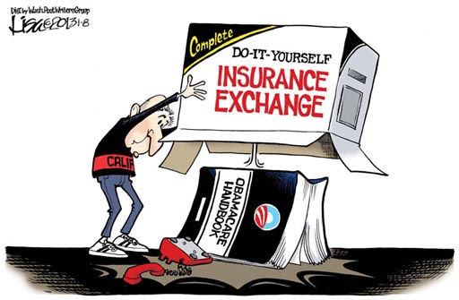
Who Wants to Play Exchange?

Slide 50
Exchanges “Can” Create Effective Competition
Allow for scale economies in purchasing (volume discounts for all)
Standardization of benefits allows for ease of comparison of health plans and ACOs
Risk-adjusted payment can be used to reward providers who serve high risk enrollees
Range of choices can be offered
Adverse selection can be reduced by rules for participation (and tax exemption)
Notes:
Adverse selection is a big deal. Who will participate in exchanges? Role of risk selection and self-funding. Smaller and smaller firms are self-insuring.

Slide 51
Health Insurance Exchanges
2014 requirement for the Patient Protection and Affordable Care Act
3 Options (http://healthreform.kff.org/the-states.aspx)
  State organized and run (18 approved 01/03/13)
    Including Minnesota, Idaho, and Massachusetts
  Partnership with Feds (2)
    Arkansas and Delaware
  Federally Facilitated Exchange (FFE)- Wisconsin

Slide 52
Rules for Exchanges
Marketplace for health insurance for individuals & small groups (< 100 employees)
Online website to gain information, express preferences and select a plan
Safety net programs may or not be in exchange
Sliding scale of subsidies for singles up to $44,700 and up to $92,000 for family of 4
Age-adjusted charges with older group premiums limited to <=3 times the youngest group
4 insurance levels based upon deductible size
Notes:
Medicaid participation and Gov. Walker’s proposal.

Slide 53
Challenges for Exchange Implementation
Time line is tight
Complexity – more than involved with Medicare Part D
Essential Health Benefits definition – higher premiums both in and outside exchange
Implementation – IT infrastructure & distribution of payments
Sustainability – Fed funding only for 2014
Awareness + enrollment information
Provider network building- both narrow and broad networks
Payer-provider-consumer relations – pricing transparency

Slide 54
Employer Provided Insurance Under Health Reform -2014
Penalty on employers for not offering affordable insurance (if 50 + full time ee) - $2,000 per full time employee (after first 30)
Premium tax credits to purchase insurance for people w/ family income < 400% of poverty level
Tax exemption to offer insurance remains
In 2014, incentive for employers to offer insurance = value of tax exemption + value of avoided penalty – value of exchange subsidy claimed by workers if they purchase through exchange

Slide 55
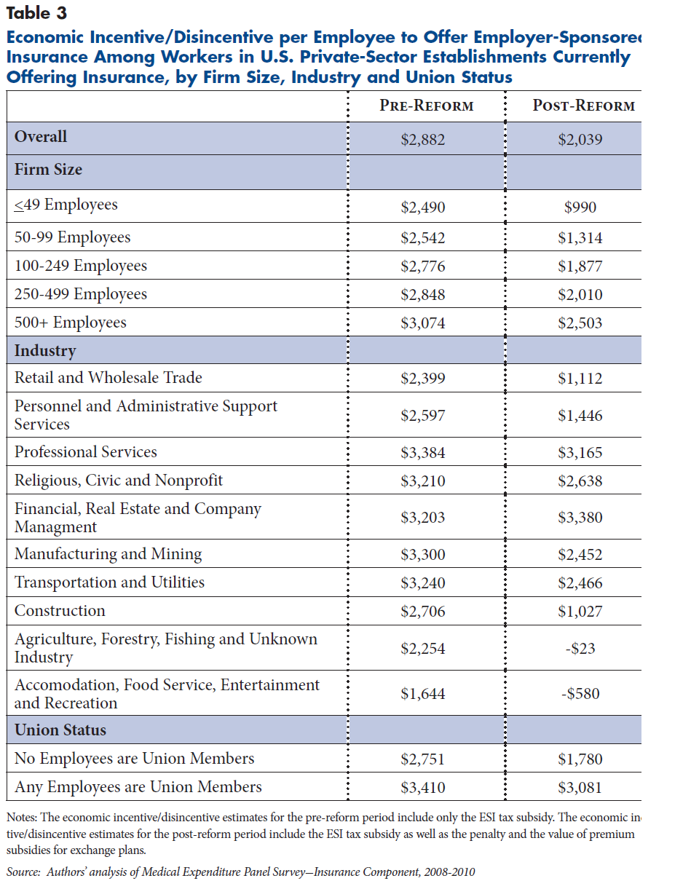
Incentives Under Health Reform
Notes:
Self-insurance and small companies.

Slide 56
Commentary on Health Reform
Insurance markets will change as individuals and employees of small companies will have opportunities to be covered by exchanges
Rules require similar prices inside and outside exchange for health plans. Premiums might rise given narrowed bands for age groups
Bundling will be much more common – Medicare has four bundling plans, just released
Various CMS experiments related to increasing value / $ spent

Slide 57
Does “Moneyball” Apply to Health Care?
Michael Lewis (2003) argues that baseball GMs can field winning teams by using measurement and predictive modeling to determine which players to sign with a limited budget.
Measurement and predictive modeling are also essential to determine which health care components and practitioners can be combined to yield the best health outcomes given limited budgets.

Slide 58
Predictive Modeling
Definition: use of risk adjustment measures and statistical analysis to identify people with high medical need who will likely benefit from managed interventions.
Examples
  Predict chance of duration of illness or survival
  Predict progression of disease in terms of risk
  Predict probability of adverse events based on selected treatment regimes
Adopted predictive models must demonstrate clinical and methodological validity

Slide 59
Implications of Predictive Modeling
Predictive modeling can be used to design and coordinate care delivery
Risk identification allows for targeting of appropriate health and wellness initiatives
Can be used within exchanges (HIE) to adjust payments to providers based on risk rather than based on services rendered
Development of value-based insurance plans that can be encouraged by employers or HIEs

Slide 60
Impact of Ambulatory Care Coordination

Slide 61
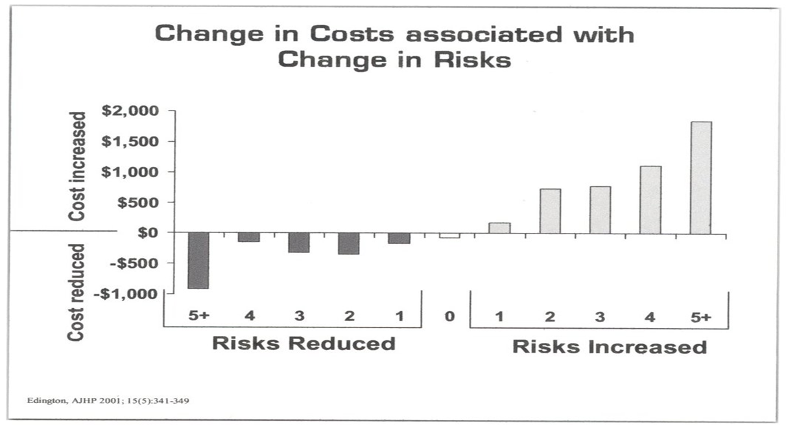
Risk Reduction is Cost-Effective

Slide 62
Recent Wisconsin Example on Use of Predictive Modeling (PM)
754 of 850 employees completed an HRA
HRA w/ PM estimated that 60 individuals @risk for colon cancer
Colonoscopies purchased at discount
38 individuals had precancerous polyps removed
Early detection and removal of polyps led to reduced number of colon cancer cases and reduced cost
Total cost: $108k; Potential cost avoided $209K
Assuming 10 years of cancer free life, ROI = 4.4:1

Slide 63
Value Based Insurance Design (VBID)
Value = clinical benefit gained per dollar spent
VBID requires both useful information (based on evidence and predictive modeling) and appropriate incentives
VBID targets insurance coverage to ↓cost sharing for interventions known to be effective and ↑cost sharing for high cost interventions that offer little or no benefit
Especially helpful for those who suffer from chronic disease.
VBID aligns incentives with high value services.

Slide 64
VBID is fiscally responsible
Targets both those who will benefit the most and in what context – e.g., diabetes and RX that reduce the probability of an adverse event. This improves adherence to care management plan
Costs are shifted onto those who seek low value – high cost interventions
Productivity is increased as absenteeism and presenteeism decline.

Slide 65
Suggested Guidance for Health Care Management
Focus on the total burden of illness, not component cost control
Develop and nurture long term coordination among patients, providers, and payers - purpose of Accountable Care Organizations and Medical Homes
Identify health risk factors and choose health programs and benefit designs to reduce them
  Pertinent for large employers and exchanges

Slide 66
Guidance Continued
Invest in the information (including evidence-based guidelines) and communication infrastructure for prevention – HRAs and health plan comparisons
Provide incentives for enrollees, providers, and payers to reward performance consistent with reduced risks and illness burdens – flat employer contribution, incentives to complete an HRA, incentives to join chronic disease management program

Slide 67
Part III - Asset Management Questions
What return on assets is required to meet ongoing and prospective objectives?
To what degree can the enterprise afford downside risk? (10%, 20%, 30% of value)
How capable is the firm of managing volatile markets? Should firm purchase insurance or assets with low downside risk?
What time frame is used for decision-making? – cash flow needs by time period

Slide 68
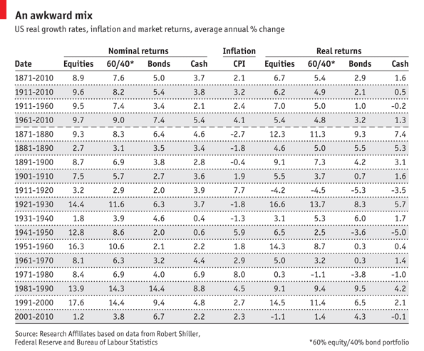
Returns on Asset by Type

Slide 69
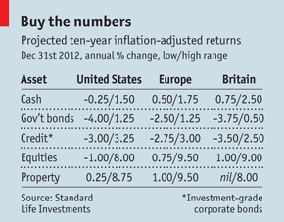
Prospective Returns Next Decade

Slide 70
3 Maxims for Health Plan Sponsors and Health Systems Organizers
The Health Care world is round, not flat
  Consumers need to understand complex choices
The 80-20 rule applies to health care
  Manage existent and potential chronic disease
What you purchase matters more than whether you get a good price
  Encourage care with B >> C
Predictive Modeling is essential to implement all three directives

Slide 71
Health Risk Management
For health and productivity management absenteeism and presenteeism policies must be clear and purposeful. If key personnel cannot perform at desired level, what backup exists?
To what degree does the firm wish to select and encourage cost-worthy and only cost-worthy health care?
To what degree does the firm want to intervene in the health care choices of its employees?

Slide 72
Health Plans: Value + Choice
If objective is to maximize choice (of providers), then subsidized payment must be limited and not directed to certain choices.
If objective is to purchase cost-worthy and only cost-worthy care, then choice must be limited & high funding coverage provided.
Predictive modeling is especially useful in addressing the latter approach to identify
  Cost-effective health management
  Productivity improvement

Slide 73
Don’t Expect Public Policy to Solve Your Problem
Former Colorado Governor Richard Lamm put it best:
“The dilemma of democracy is that citizens want more services as consumers than they are willing to pay for as taxpayers.”
“The ultimate challenge to an aging, technology-based society is to adjust public expectations to what the society can realistically afford.”

Slide 74
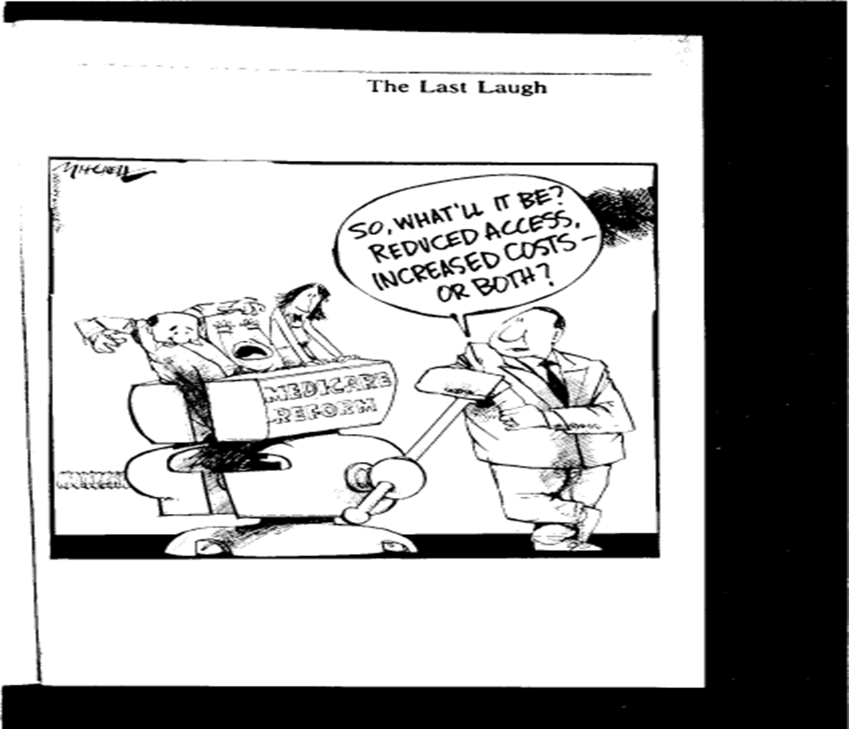
The Big Tradeoff

Slide 75
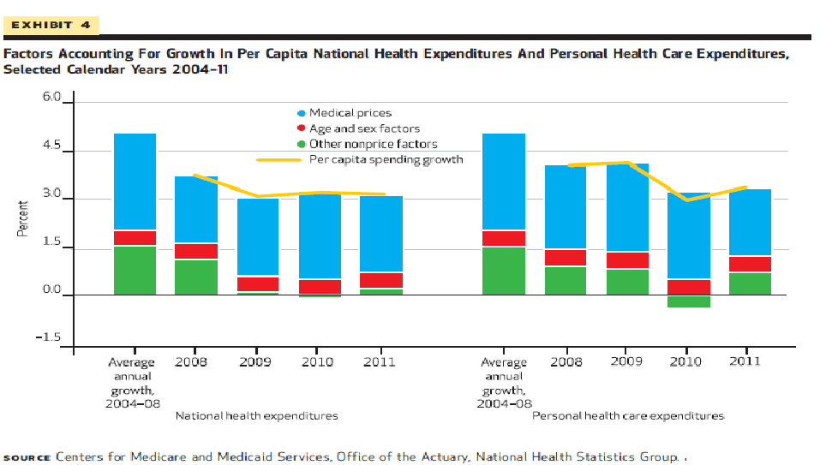
Accounting for Health Expenditures

Slide 76
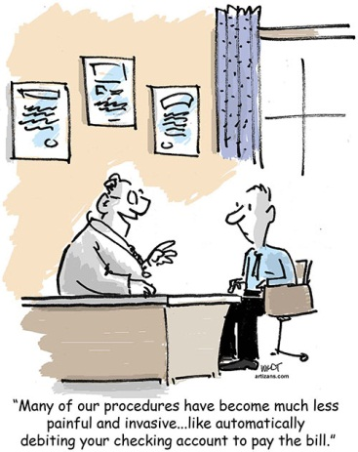
Automatic Debiting

Slide 77
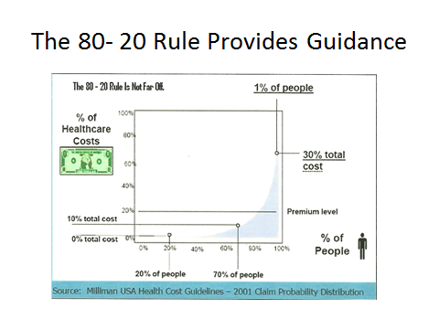

Slide 78
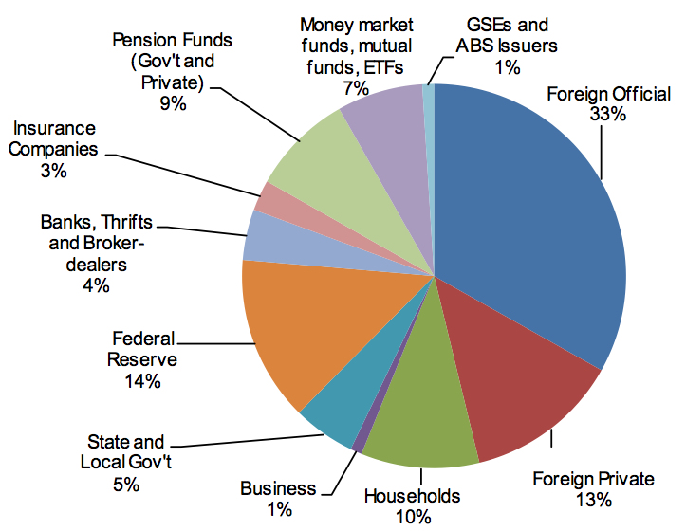
Who Holds Marketed Treasuries?

